Slide 1
ncda annual conference St. Paul, MN – June 2022
Building Administrative Capacity
Presented by: Heather Royall
Housing Stability Division
Salt Lake City, Utah
Notes:
Heather

Slide 2
Administrative Capacity: Having adequate staff and resources to operate and comply with federal, state and local funding, for the delivery of programs and timely services to residents and the community at-large.

Slide 4
CAPACITY BUILDING PRINCIPLES
Assess your needs
Formulate a plan
Engage stakeholders
Define your processes
Implement
Continually reassess
Plan for your plan to change
Use data to drive decisions

Slide 5
CAPACITY BUILDING Best practices
Learn to see the big picture
Have clearly defined processes
Stay organized
Build sustainable partnerships
Foster public-private partnerships
Leverage other dept./div.
Leverage community partners
Cross train!!

Slide 6
Levels of analysis
Federal Regulations
City Policies & Procedures
Program Needs
Community/Resident Needs

Slide 8
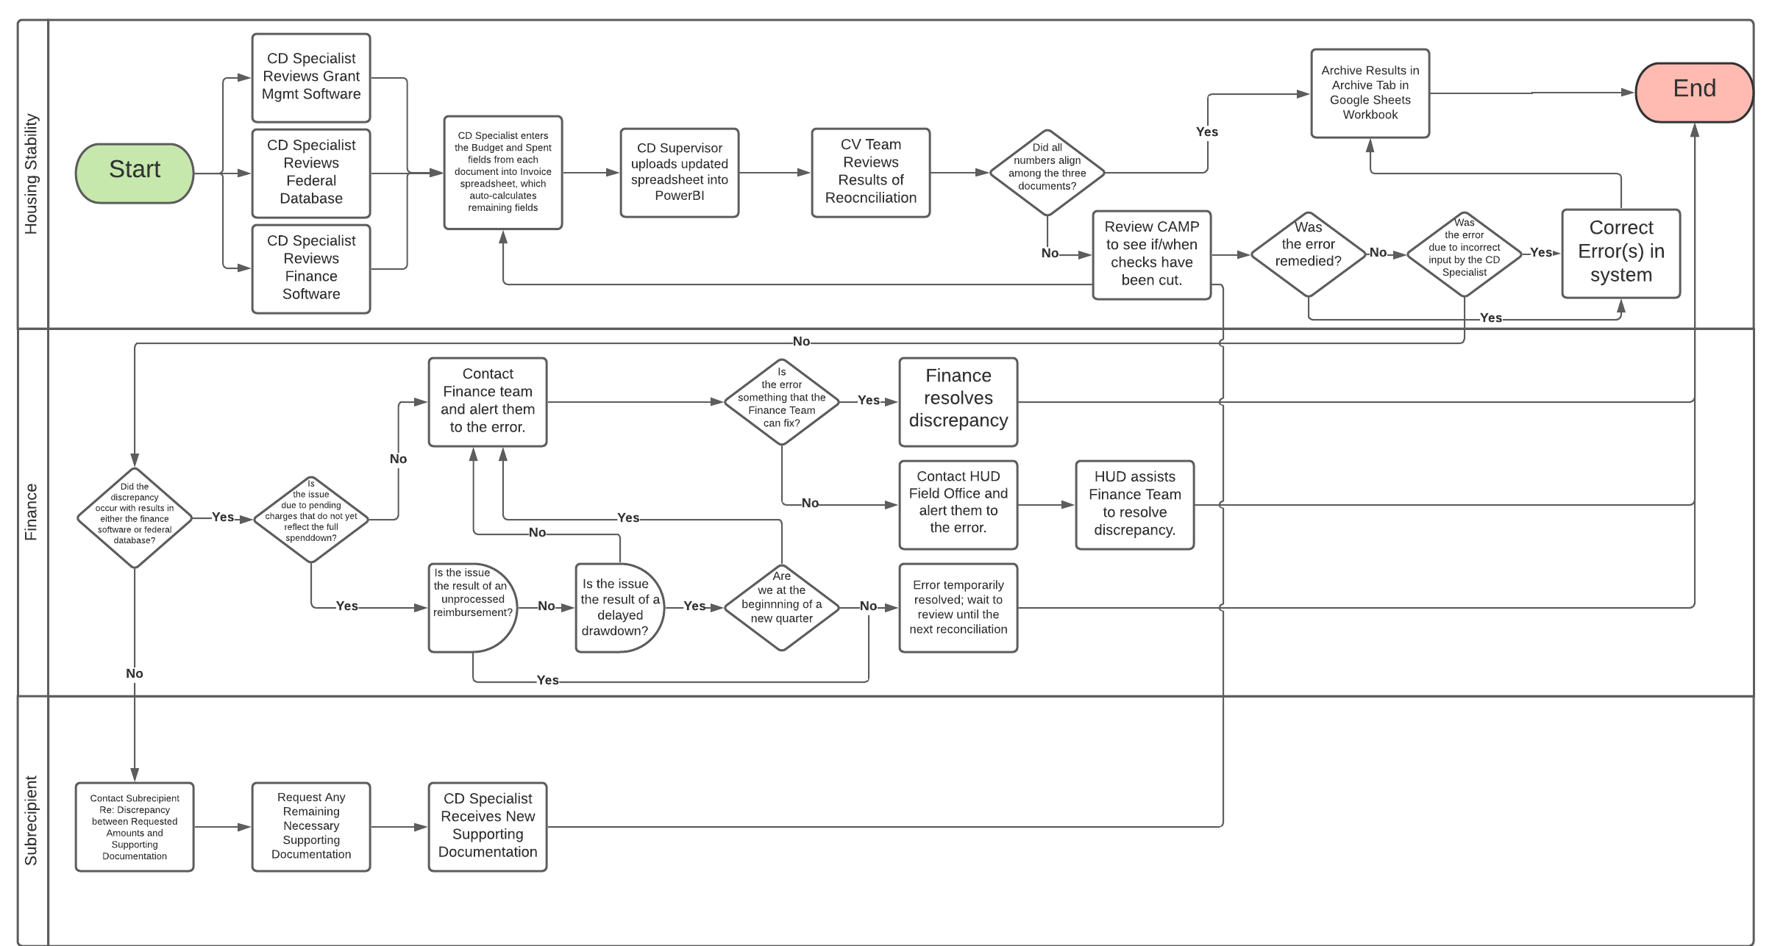
Workflow mapping

Slide 9
TASK Board
Deadlines | New | In Queue | In Progress | Ongoing | Completed
Review New CV Waiver
Update CDBG-CV PPR Tieback Statements
Coordinate with Salt Lake County
Review ESG-CV Spend Down Plan with Heather
80%
ESG-CV Spend Down Deadline
Review New CV Waiver
Research CFRs
KT
TD
AL
AL
KT
TD
TD
Quarterly Spend Down Deadline
Meet with HOPWA-CV Subgrantee
Review New CV Waiver
Vaccination Coordination
Review New CV Waiver
KT
AL
KT
TD
TD
KT
TD
CAPER Due
Review New CV Waiver
TD
TD

Slide 10
Tools used
Trello to stay organized and task oriented
Lucid to create process mapping and flowcharts
Power BI for dashboards and data analysis
Canva for announcements, flyers and graphics
Dropbox for document sharing and collaboration
Microsoft Office Suite
Regular one-on-ones and team meetings
Foster collaborative, opportunity-based environment
Regular opportunities for training

Slide 11
Outcomes
Robust policies and procedures
Ability to track and maintain expenses
Ongoing community partnerships
Ability to make data driven decisions
Additional grant funding
Proper capacity to administer funding & programs
Increased ability to retain knowledgeable staff
Residents and the community receive better access to more services
Empowered to move forward and expand

Slide 12
CONTACT INFORMATION
Heather Royall
heather.royall@slcgov.com
801-535-7273 or 385-977-0935
Notes:
Heather

